Slide 1
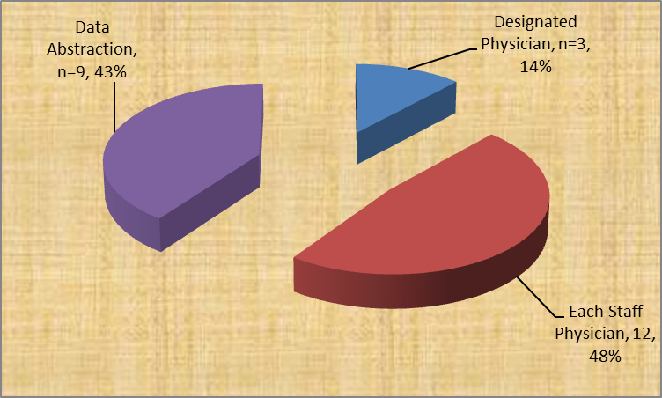
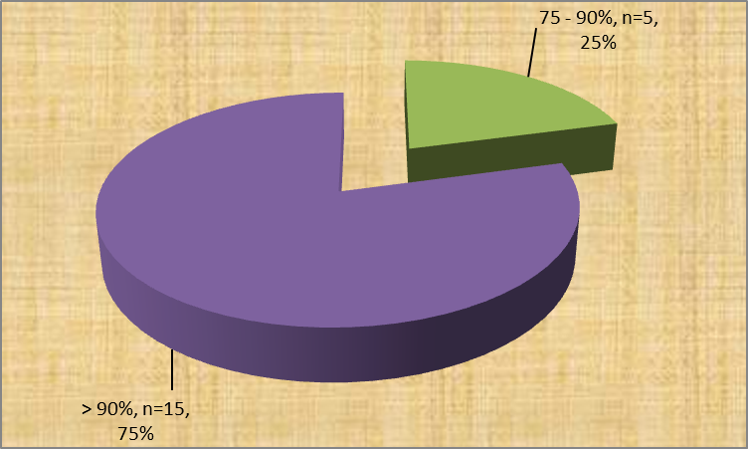
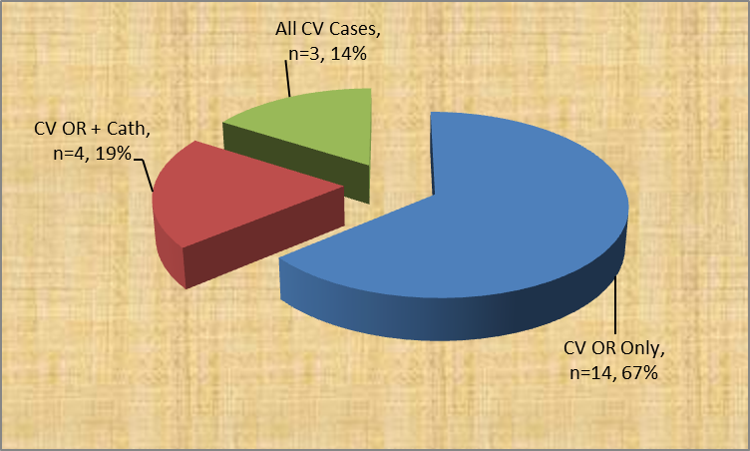
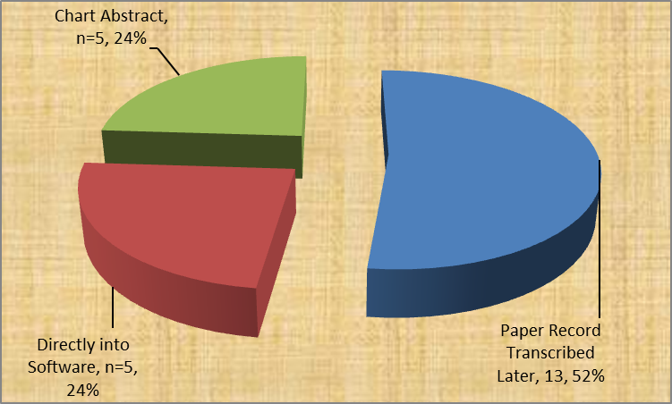
David F. Vener, M.D.*, Nina Guzzetta, M.D.+, Mark Twite, M.B.#, Glyn Williams, M.B. ChB^
*Depts. of Pediatrics and Anesthesia, Texas Children’s Hospital/Baylor College of Medicine, Houston, TX, +Dept. of Anesthesia, Children’s Healthcare of Atlanta/Emory University, Atlanta, GA,
#Dept. of Anesthesia, Children’s Hospital of Denver, Denver, CO, ^Dept. of Anesthesia, Lucille Packard Children’s Hospital/Stanford University, Palo Alto, CA
Mechanisms of Reporting Anesthesia Information into the CCAS – STS Database
An email survey of the 31 programs participating in the Society of Thoracic Surgeons (STS) Congenital Surgery database – Congenital Cardiac Anesthesia (CCAS) database between 2010 – 2012 was undertaken by the authors on behalf of the CCAS Database committee. Contact information for each of the sites was obtained by personal correspondence and from the STS. The brief survey inquired into what type of information was submitted by each site: Cardiac Surgery Only, Cardiac Surgery + Cardiac Cath Lab, or All Sites (including General OR, Radiology, and ICU). Additionally, each site was asked about the personnel involved and how they entered the data into their database software. The STS currently lists 31 sites as participating in the anesthesia portion of the congenital database (out of 101 surgical participants), but 2 of the sites listed only the participating anesthesiologists name with no other data provided. 25 sites responded to the survey. One of the sites utilizes the database but has not begun submitting it yet to the national data warehouse for analysis. The results of the survey are illustrated. 64% (16/25) of the programs indicated that they are currently utilizing the data for Quality Improvement initiatives.
What percentage of cases do you estimate are captured?
Who is responsible for entering the data?
How is data entered into the STS database?
What cases do you capture?

